Slide 1
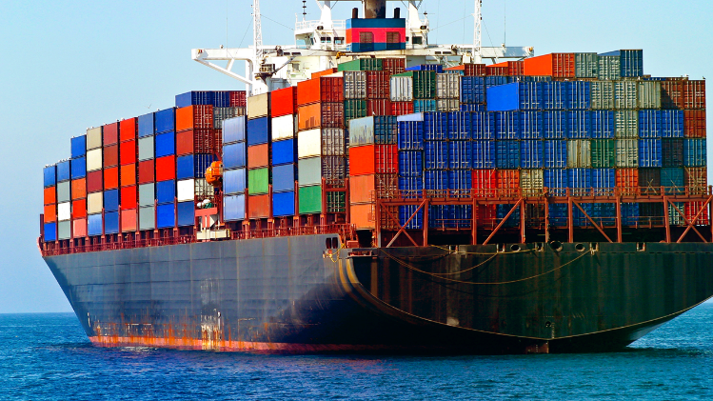
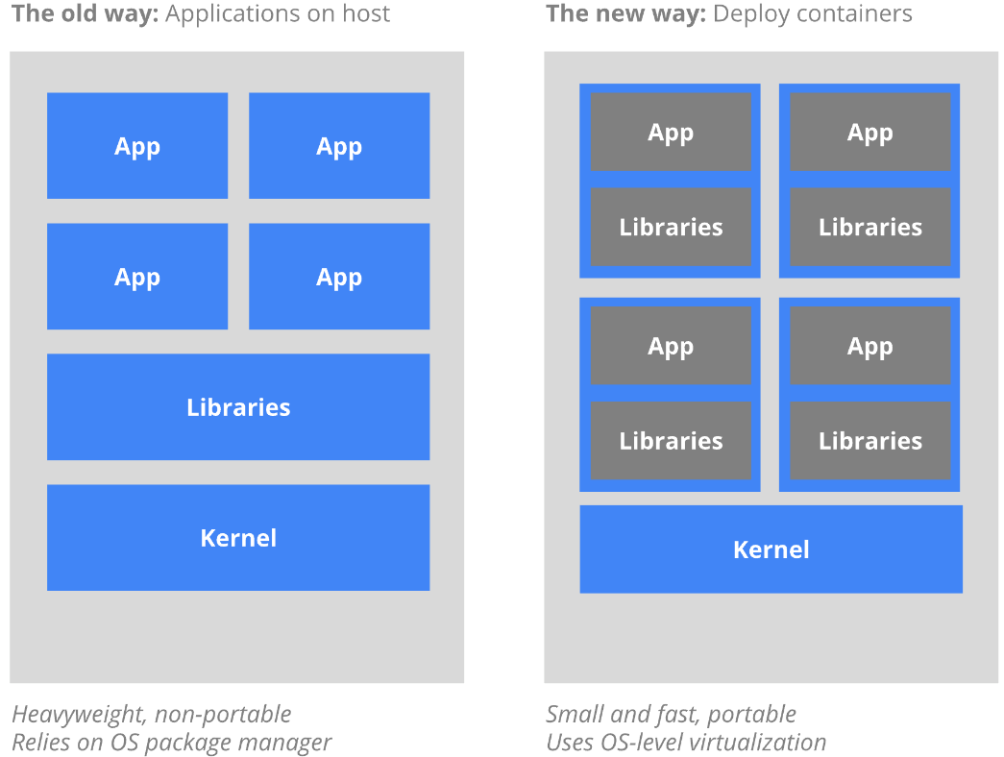
What is containerization
Containers
Like shipping containers
Standard packaging
Isolation method
Composability
Deployment
Takes mins or secs
Portable
Very efficient

Slide 2
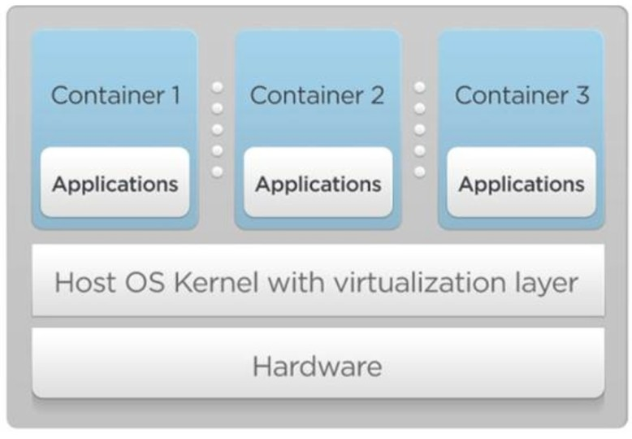
OS virtualization through containers
Containers are “lightweight” VMs
A virtual environment for a service that groups and isolates the processes and resources belonging to the service
Containers share OS kernel of the host
Cannot install a Windows container on a Linux host or vice-versa
No hypervisor. OS provides necessary support (e.g., resource isolation)

Slide 3
Benefits of containerization
Fast provisioning: applications can be deployed very fast, without the need to install or configure other software
Performance: bare-metal like performance
Lightweight: Containers leverage and share the host kernel
Portable: Build locally, deploy to the cloud, run anywhere
Scalable: Increase and automatically distribute container replicas
Interchangeable: Deploy updates and upgrades on-the-fly
Stackable: Stack services vertically and on-the-fly
Example: microservices (reading: https://microservices.io/)

Slide 4
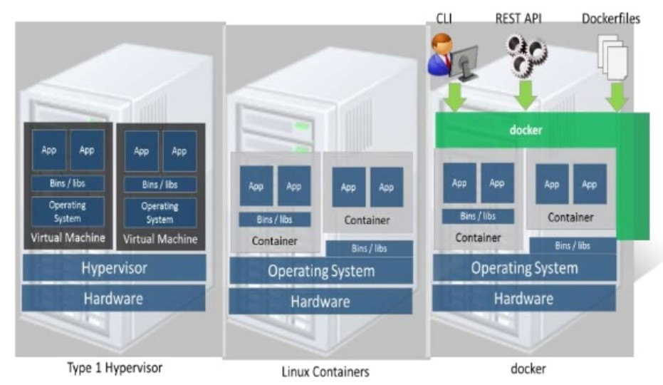
Docker containers
A tool for portable container deployment across machines
Used for app deployment
Create containers from build files
Built on top of Linux Containers
Set of kernel features that provide process-based resource isolation, limits, prioritization, accounting, control, etc.
The use of Linux containers to deploy applications is called containerization
https://docs.docker.com/

Slide 5
Containerization with Docker
Container image
An executable package that includes everything needed to run an application -- the code, a runtime, libraries, environment variables, and configuration files
A container is launched by running an image
Runtime container
An instance of an image -- what the image becomes in memory when executed (i.e., an image with state, or a user process).

Slide 6
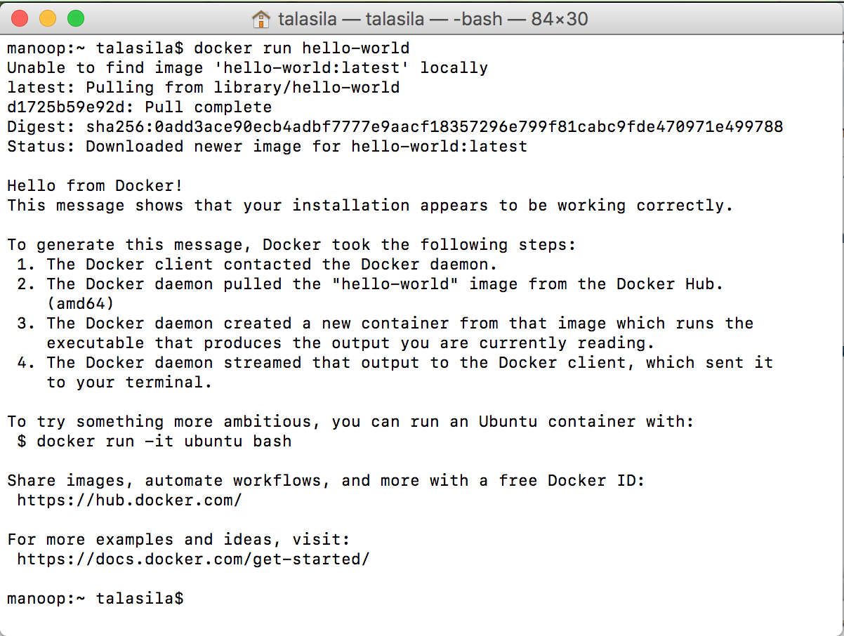

Building and running a Docker image (1)
Docker Install
https://www.docker.com/get-started
For easy steps, let’s consider Mac (Linux works well, too)
Install Docker.dmg to get the docker host running
Run it – “docker run hello-world” (downloads application from public Docker Hub)
Windows works, but it’s not as straightforward as Mac/Linux

Slide 7
Building and running a Docker image (2)
Creation of Dockerfile
Dockerfile defines what goes on in the environment inside your container
Save file named “Dockerfile” as shown in the example
This Dockerfile refers to a couple of files (not created yet)
app.py and requirements.txt
Docker container with
Linux & Python
Dockerfile example
# Use an official Python runtime as a parent image
FROM python:2.7-slim
# Set the working directory to /app
WORKDIR /app
# Copy the current directory contents into the container at /app
COPY . /app
# Install any needed packages specified in requirements.txt
RUN pip install --trusted-host pypi.python.org -r requirements.txt
# Make port 80 available to the world outside this container
EXPOSE 80
# Define environment variable
ENV NAME World
# Run app.py when the container launches
CMD ["python", "app.py"]
Installed Python libraries
required by our app

Slide 8
Building and Running a Docker Image (3)
app.py example
Requirements file
Flask is web framework for building web apps
Redis: in-memory cache
Application – app.py
Build the app with this command:
“docker build -t myapp .”
from flask import Flask
from redis import Redis, RedisError
import os
import socket
# Connect to Redis
redis = Redis(host="redis", db=0, socket_connect_timeout=2, socket_timeout=2)
app = Flask(__name__)
@app.route("/")
def hello():
try:
visits = redis.incr("counter")
except RedisError:
visits = "<i>cannot connect to Redis, counter disabled</i>"
html = "<h3>Hello {name}!</h3>" \
"<b>Hostname:</b> {hostname}<br/>" \
"<b>Visits:</b> {visits}"
return html.format(name=os.getenv("NAME", "world"), hostname=socket.gethostname(), visits=visits)
if __name__ == "__main__":
app.run(host='0.0.0.0', port=80)
requirements.txt example
Flask
Redis

Slide 9
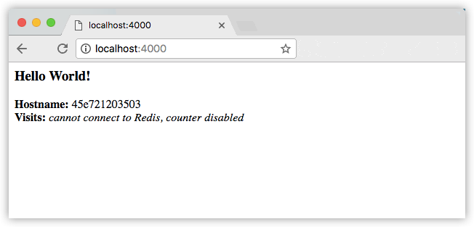
Building and Running a Docker Image (4)
View the image
Command: “docker image ls”
Run the app
You should see a message that Python is serving your app at http://0.0.0.0:80.
But that message is coming from inside the container, which doesn’t know you mapped port 80 of that container to 4000, making the correct URL http://localhost:4000
REPOSITORY TAG IMAGE ID
myapp latest 326387cea398
docker run -p 4000:80 myapp

Slide 10
Docker Hub (1)
Docker Hub is a cloud-based repository in which Docker users create, test, store, and distribute container images
Need to create account
Can set access permissions
$ docker container ls
CONTAINER ID IMAGE COMMAND CREATED
1fa4ab2cf395 myapp "python app.py" 28 seconds ago
Find container and stop it
See the running Docker container using the “ls” command
Use “stop” command to end the process, using the CONTAINER ID
Share your image in Docker Hub
To demonstrate the portability of what we just created, let’s upload our built image and run it somewhere else
Docker’s public registry - hub.docker.com
docker container stop 1fa4ab2cf395
$ docker login

Slide 11
Docker Hub (2)
Tag the image (Prereq - “docker login host:port”)
“docker tag image username/repository:tag”
Publish the image in the public docker hub
“docker push username/repository:tag”
Pull and run the image from the remote repository
“docker run -p 4000:80 username/repository:tag”
You can use the “run” command to execute your app on any machine
docker tag myapp talasila/get-started:version1
docker push talasila/get-started:version1
docker run -p 4000:80 talasila/get-started:version1

Slide 12
Docker Hub (3)
The first time ”docker run” executes for our container, it pulls the image along with Python and all the dependencies from requirements.txt; then, it runs the code
Subsequent runs use the downloaded code
The container travels in a package, and you don’t need to install anything on the host machine for Docker to run it
https://hub.docker.com/r/jenkins/jenkins/

Slide 13
Container Orchestration (1)
Tools for containerized applications that provide:
Automated deployment
Scaling
Management
Examples:
Docker compose: https://docs.docker.com/compose/ & Docker swarm: https://docs.docker.com/engine/swarm/
Kubernetes: https://kubernetes.io/

Slide 14
Container Orchestration (2)
In a distributed application, different pieces of the app are called microservices
Each service can be its own docker image and can run in multiple container instances (e.g., for scaling purposes)
It’s very easy to define, run, and scale services with the Docker platform – using docker-compose.yml
Docker compose
A docker-compose.yml file is a YAML file that defines how Docker containers should behave in production
https://docs.docker.com/compose/

Slide 15
Container Orchestration (3)
Deploy application onto a cluster, running it on multiple machines
Multi-container, multi-machine applications are enabled by a “Dockerized” cluster, called a swarm
A swarm is a group of machines that run Docker and join into a cluster
Swarm managers can use several strategies to run containers:
“Emptiest node” -- fills the least utilized machines with containers
“Global” -- ensures that each machine gets exactly one instance of the specified container
Instruct the swarm manager to use these strategies in the Compose file

